Slide 1
Hand Gesture Recognition Using an Adapted Convolutional Neural Network with
Data Augmentation
Divyanshu Pant
Minu Rajeeve Payyapilly

Slide 2
Introduction/Problem Description
Hand gesture recognition is an important aspect of Human Computer Interaction.
Most apparent non verbal communication is done with the help of hand gestures and hence, it is important to develop methods by which computers can identify human hand gestures.
This problem can find further use-cases in the form of sign language recognition, ease of access for target groups, virtual reality applications and many more.
Notes:
It is easier for humans to use their hands rather than other tools.
Target groups - Disabled people, elderly people, situations where human presence is difficult/dangerous but require human control.

Slide 3
Introduction/Problem Description
A number of solutions can be proposed for the task at hand. Some important qualities that are desirable in a solution are:
ACCURACY
SPEED
GENERAL FEASIBILITY
Notes:
This is dependent on the use-case, but generally the solution should be able to properly classify most hand gestures within reasonable deviation.
For real time applications especially, the solution should be fast enough.reasonable deviation.
This considers other factors such as the equipment used, the scalability of the solution, the cost required to implement it, the ease of use and many other factors.

Slide 4
Solution: using Deep Learning model
The method used in the paper selected by us is the deep learning method which solves the problem with reasonably high accuracy and once trained it gives the results fast. The main challenge faced by this method is the collection of the datasets, appropriate pre-processing and the subsequent time taken for training the models.

Slide 5
Summary Of the Paper Chosen
What does the model do?
Convolutional Neural Network
Baseline Convolutional Neural Network
Adapted Deep Convolutional Neural Network
Experimental Methodology
Results

Slide 6
What does the model do?
The CNN Models take input of hand gestures in the form of image and gives the classified output - the most matching hand gesture label.
The paper uses The LSP dataset which contains 6 hand gesture classes used in the sign language of Peru.
In our implementation we have used 3 dataset containing 6 hand gesture classes.
Notes:
The features extracted from a CNN using the three types of layers are hierarchical. The bottom layers in a CNN collect the low-level features and high-level layers collect and learn features with more abstract information; this is useful for classification tasks
The feature map is the output of one filter applied to the previous layer. A given filter is drawn across the entire previous layer, moved one pixel at a time. Each position results in an activation of the neuron and the output is collected in the feature map.

Slide 7
Convolutional Neural Network
The CNN contains three types of layers; namely,
1. Convolutional layer
2. Subsampling or pooling layer
3. Fully connected layer
CNN architecture is obtained by stacking several of the above-mentioned layers.
Notes:
The features extracted from a CNN using the three types of layers are hierarchical. The bottom layers in a CNN collect the low-level features and high-level layers collect and learn features with more abstract information; this is useful for classification tasks
The feature map is the output of one filter applied to the previous layer. A given filter is drawn across the entire previous layer, moved one pixel at a time. Each position results in an activation of the neuron and the output is collected in the feature map.

Slide 8
How does CNN work?
A neural network is made up of many artificial neurons. These artificial neurons are connected together to create a CNN using a topology known as a feed-forward network.
A convolution layer investigates the spatially-local correlation of its input and maps it into the next layer, which is called a feature map. Different feature maps are constructed from different kernels.
Notes:
This means that the neurons in each layer feed their output forward to the next layer until we get a final output
The feature map is the output of one filter applied to the previous layer. A given filter is drawn across the entire previous layer, moved one pixel at a time. Each position results in an activation of the neuron and the output is collected in the feature map.

Slide 9
Baseline Convolutional Neural Network
Baseline deep CNN design is composed of two convolutional layers, two pooling layers and two fully connected layers with ReLU .
Three dropout performances : two dropout procedures after the two pooling layers, and the third dropout is performed after the first fully connected layer.
Notes:
Dropout is a technique used to prevent a model from overfitting. Dropout works by randomly setting the outgoing edges of hidden units to 0 at each update of the training phase.

Slide 10
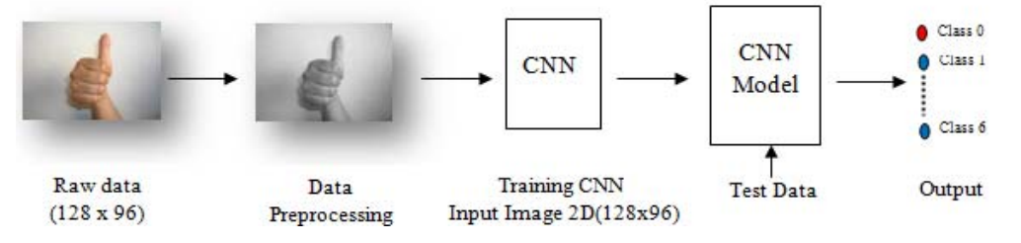
Stages of Hand Gesture Recognition Model
Preprocessing in the first stage
Pattern classification using CNN deep learning algorithm with two different architectures in the second stage.
Notes:
1) preprocessing in the first stage; and 2) pattern classification using CNN deep learning algorithm with two different architectures in the second stage.

Slide 11
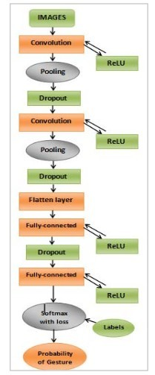
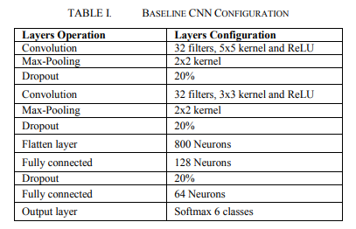
Baseline CNN Configuration
Notes:
ReLU activation function:The rectified linear activation function or ReLU for short is a piecewise linear function that will output the input directly if it is positive, otherwise, it will output zero
Softmax activation function:The softmax function is used as the activation function in the output layer of neural network models that predict a multi class classification problem.
The baseline deep CNN design is composed of two convolutional layers, two pooling layers and two fully connected layers with ReLU.
There are two dropout procedures after the two pooling layers, and the third dropout is performed after the first fully connected layer.
The first convolutional layer has a kernel size of 5x5 pixels that contains 32 feature maps with a ReLU activation function
The Max-Pooling layer uses the maximum value to progressively reduce the spatial size of the representation to reduce the amount of parameters and computation in the network, and hence to also control overfitting
The next layer is a regularization layer (Dropout) that was configured to randomly exclude 20 percent of neurons to reduce overfitting
The next hidden layer is a convolutional layer that has a kernel size of 3×3 pixels and also contains 32 feature maps with a ReLU activation function. This layer is followed by another pooling and regularization layer that is the same as the previous layer. Afterwards, a layer called Flatten converts the two-dimensional matrix data to a vector, thereby allowing the final output to be processed by standard fully connected layers to obtain the next layers
The first fully connected layer with the ReLU activation function contains 128 neurons. This is followed by a dropout layer to exclude 20% of neurons to reduce overfitting. The second fully connected layer containing 64 neurons with the ReLU activation function that receiving the previous 128- dimensional output of the first fully connected layer. The final part of the CNN structure is the output layer which comprises a Softmax activation function, and contains 6 neurons, one for each hand gesture recognition class.

Slide 12
Adapted Deep Convolutional Neural Network
The performance of the baseline CNN was improved by tuning the parameters to include network initialization and regularization. The proposed approach also includes data augmentation
Network initialization:
initializing the weights in an appropriate way can significantly influence how easily the network learns from the training set.
The ADCNN network architecture uses the uniform He initialization (he_uniform) for all ReLU layers and the uniform Xavier initialization (glorot_uniform) for the output Softmax layer (for effective generalization of the logistic function for multiple inputs).
Notes:
He Weight Initialization
The he initialization method is calculated as a random number with a Gaussian probability distribution (G) with a mean of 0.0 and a standard deviation of sqrt(2/n), where n is the number of inputs to the node.
· weight = G (0.0, sqrt(2/n))
Xavier Weight Initialization
The xavier initialization method is calculated as a random number with a uniform probability distribution (U) between the range -(1/sqrt(n)) and 1/sqrt(n), where n is the number of inputs to the node.
· weight = U [-(1/sqrt(n)), 1/sqrt(n)]
We can implement this directly in Python.
The example below assumes 10 inputs to a node, then calculates the lower and upper bounds of the range and calculates 1,000 initial weight values that could be used for the nodes in a layer or a network that uses the sigmoid or tanh activation function.
After calculating the weights, the lower and upper bounds are printed as are the min, max, mean, and standard deviation of the generated weights.

Slide 13
Adapted Deep Convolutional Neural Network
L2 Regularization:
This aims to decrease the complexity of the model while maintaining the same parameter count. L2 regularization does so by penalizing weights with large magnitudes, by minimizing their L2 norm.
It uses a hyper parameter λ = 0.0001 to specify the relative importance of minimizing the norm to minimizing the loss on the training set.
Data Augmentation:
Data augmentation can be used to reduce overfitting as well as improve the classifier as its able to learn better from a variety of images about the same gesture.

Slide 14
Adapted Deep Convolutional Neural Network
random horizontal and vertical shifts were applied to the data to derive new images
using data augmentation the images are shifted both horizontally and vertically to an extent of 20% of the original dimensions randomly, in order to numerically increase the size of the dataset and to add the robustness needed for a deep learning approach.

Slide 15
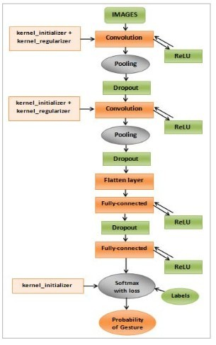
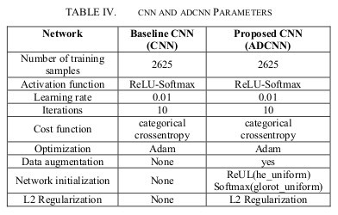
ADCNN Architecture

Slide 16


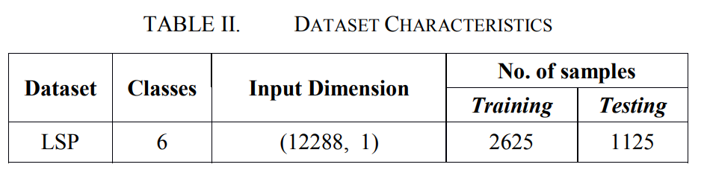




Experimental Methodology: 1. Dataset
The LSP dataset contains hand gestures used in the sign language of Peru.
Each gesture belongs to one of 6 distinct classes as shown in the table.

Slide 17
Dataset
Some challenges mentioned in the paper regarding said dataset were:
Non-regular illumination of hands
Rotation of hands
Uneven hand sizes
Translation of the key components
Noise, in general

Slide 18
2. Image Pre-Processing
The convolutional layers before the first pooling layers are the bottleneck of the computational efficiency and memory requirements.
Some of the Preprocessing Steps performed:
The images are converted to gray scale
Color space conversion was also applied, permitting work on only one color channel instead of processing the three RGB channels.

Slide 19




3. Evaluation Measures

Slide 20
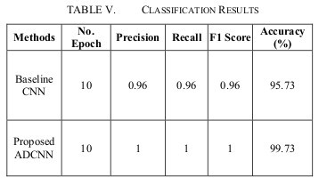
Research Paper Results
ADCNN model achieved a 99.73% accuracy compared to 95.73% accuracy of baseline CNN.

Slide 21
Implementation Results
Model | Dataset | Epochs | Precision | Recall | F1 Score | Accuracy
Baseline CNN | SL_Muhammad | 30 | 0.97 | 0.97 | 0.97 | 0.97
Proposed ADCNN | SL_Muhammad | 30 | 0.96 | 0.96 | 0.96 | 0.96
Baseline CNN | ASL | 30 | 0.94 | 0.94 | 0.94 | 0.94
Proposed ADCNN | ASL | 30 | 0.94 | 0.94 | 0.94 | 0.94
Baseline CNN | ISL | 30 | 1.0 | 1.0 | 1.0 | 1.0
Proposed ADCNN | ISL | 30 | 1.0 | 1.0 | 1.0 | 1.0

Slide 22
Chosen Issues for work
The paper gives an accuracy of 95.73% on the baseline CNN and 99.73% on the ADCNN for the LSP dataset.
Future scope mentions testing the model on other datasets, which will be the main focus of our following implementation. This might lead to reduced accuracies and increased training times.
The following modifications were attempted:
Usage of validation sets for hyperparameter tuning.
Image processing methods to reduce unnecessary features, while maintaining the features required for proper classification.
Data augmentation: Addition of random rotations and scalings along with the prescribed translations as part of the data augmentation step.

Slide 23
Proposed Modification (idea discussion)
Using different datasets to train the model, we have observed that the accuracy of the ADCNN is lower than baseline CNN, which is contrary to the paper’s claims of ADCNN being a better model.
We added further rotation and scaling to the input images, which further lowered the accuracy of the model to 95%.
In order to compensate for this, the model was allowed to run for 50 epochs, with an additional validation set of 300 images per alphabet.

Slide 24
Proposed Modification (idea discussion)
Validation testing revealed that the accuracy of the model on predicting the validation set was maximum at 45 epochs.
The model was hence allowed to train for 45 epochs, and gave a maximum accuracy of 97%, as good as the baseline, yet able to predict images with a wider range of errors and defects.
Another approach was the introduction of batchnorm layers into the model. The dropout layers were replaced with batchnorm layers. This resulted in a considerable increase in training accuracy in initial epochs.
Test accuracy was, however, highly unpredictable across epochs. Running this for 30 epochs led to a 93% test accuracy, even lower still.

Slide 25
Implementation Results Modified ADCNN (Solution discussion)
Model | epochs | Precision | Recall | F1 Score | Accuracy
Proposed ADCNN | 30 | 0.96 | 0.96 | 0.96 | 0.96
With Batch Norm | 30 | 0.94 | 0.93 | 0.93 | 0.93
With Rotation, Scaling, epochs validation | 45 | 0.97 | 0.97 | 0.97 | 0.97

Slide 26
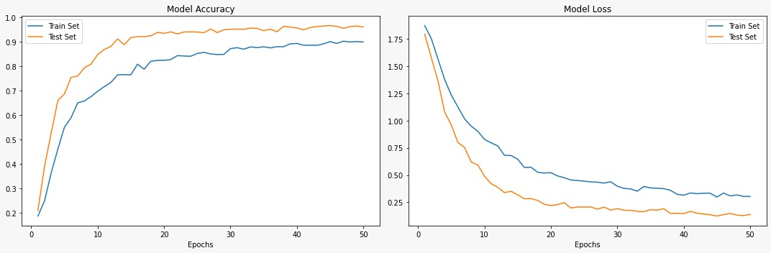
Validation Testing over a range of 50 epochs
Modified ADCNN model with rotation, scaling, epochs validation
No of epochs chosen = 45

Slide 27
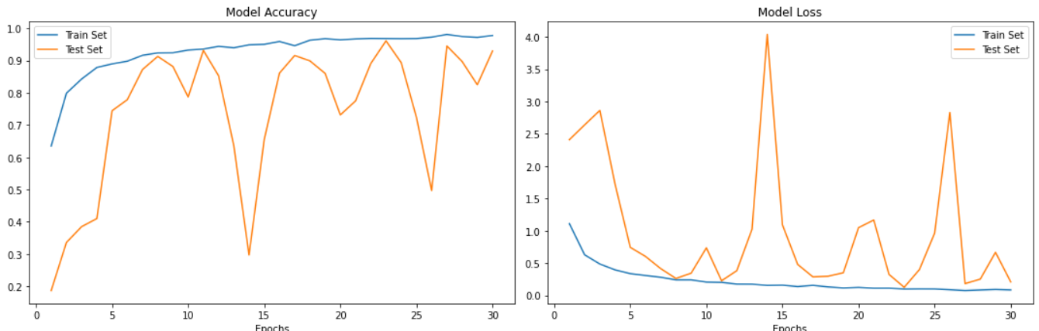
Batch Normalization accuracies over 30 epochs

Slide 28
DEMO

Slide 29
Citations
A.A.A., G.C., A.T., & T.M.M.G. (2018). Hand Gesture Recognition Using an Adapted Convolutional Neural Network with Data Augmentation. 2018 4th IEEE International Conference on Information Management.
Oudah, Munir, Ali Al-Naji, and Javaan Chahl. 2020. "Hand Gesture Recognition Based on Computer Vision: A Review of Techniques" Journal of Imaging 6, no. 8: 73.
https://www.kaggle.com/datasets/muhammadkhalid/sign-language-for-alphabets
https://www.kaggle.com/datasets/vaishnaviasonawane/indian-sign-language-dataset
https://www.kaggle.com/datasets/grassknoted/asl-alphabet

Slide 30
THANK YOU

